Slide 1
(I ES)
Intranet Email System

Slide 2
About IES
Communication : An important part of life.
Reduces over head of information collection in an organization.
Lightweight in comparison to conventional systems
Graphical user Interface
Enhanced Security features
Ease of usage
Portable and based on Liquid layout

Slide 3
Requirement Analysis
Analyzed certain private & government institutions.
Found a cause of delay in work and a common need.
The Big Problem: Lack of computer literacy
Threat of loss/leak of information : A common issue.
Employees state it to be a revolution to have a user friendly , safe and robust system.

Slide 4
Design
No long procedures to create a unique user identity.
Use of graphics and easy to understand interactions-JQuery
Unique mail preview feature.
Security due to entire development on PHP.
NO requirement of admin.

Slide 5
Time Analysis
Three software engineers were involved in development of the system.
The project required 2 months or 360 man hours for the completion and deployment.
An additional 15 days/90 man hours or less were required to add customized features.

Slide 6
Cost Analysis
The Cost Constructive model (organic) was used to estimate the cost of the system.
Three programmers hired @$350 p.m..
The other overheads incurred were the use of software resources and cost of running the equipments.
Mysql enterprise ed.-$5000
Nginx Web Server-$1200

Slide 7
Data Flow Diagram

Slide 8
Context Diagram
User
Mail details and content
0
IES
Credentials, Actions
Inbox, Sent mails
Trash mails
User

Slide 9
Level 1 DFD
D2
Mails
D1
Users
D4
Trash
1.0
User
Authentication
User
6.0
View Trash
2.0
New mail
User
Compose Mail
Mails in trash
3.0
D2
Mails
Read Mails
User
Received mails
4.0
View previously saved mails
View Drafts
User
D3
Drafts
5.0
D2
Mails
View Sent Mails
User
Previously sent mails

Slide 10
E-R Diagram

Slide 11
Type
From
Content
Mail
Msg_id
To
Create
Discards
sends
User_id
User
Sr_no
password
Deletes
Sends
Saves
Msg_id
Trash
Drafts
Content
Content
Type
Msg_id
Type

Slide 12
Further Enhancements
Use of Stegnographic data hiding
Addition of attachment feature
Provide a portability for mobile devices
Make interface compatible for touch screen devices
Implement biometrics for enhanced and fool proof security

Slide 13
Conclusion
The system was developed successfully within the scheduled time.
All the requirements were fulfilled
All the mentioned problems were solved and the system was adored.

Slide 14
Screenshots
A tour to GUI

Slide 15
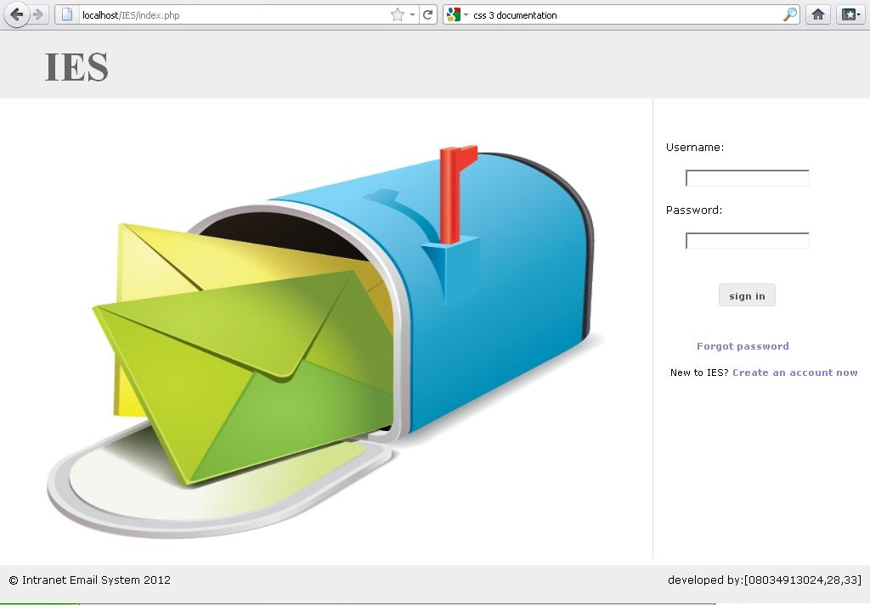
The Login

Slide 16
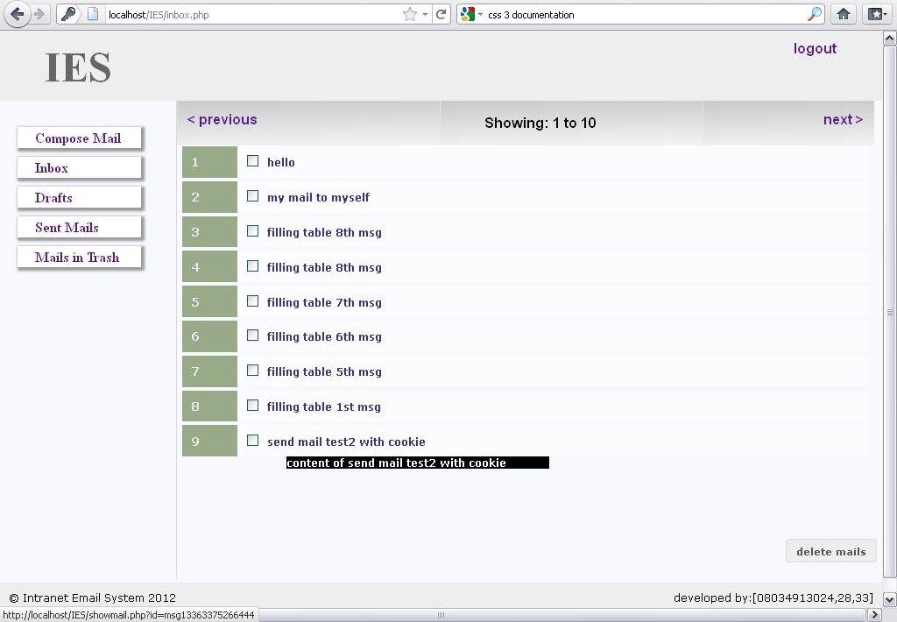
The Inbox
From : user1234
From : user1234
From : user1234
From : user1234
From : user1234
From : user1234
From : user1234
From : user1234
From : user1234

Slide 17
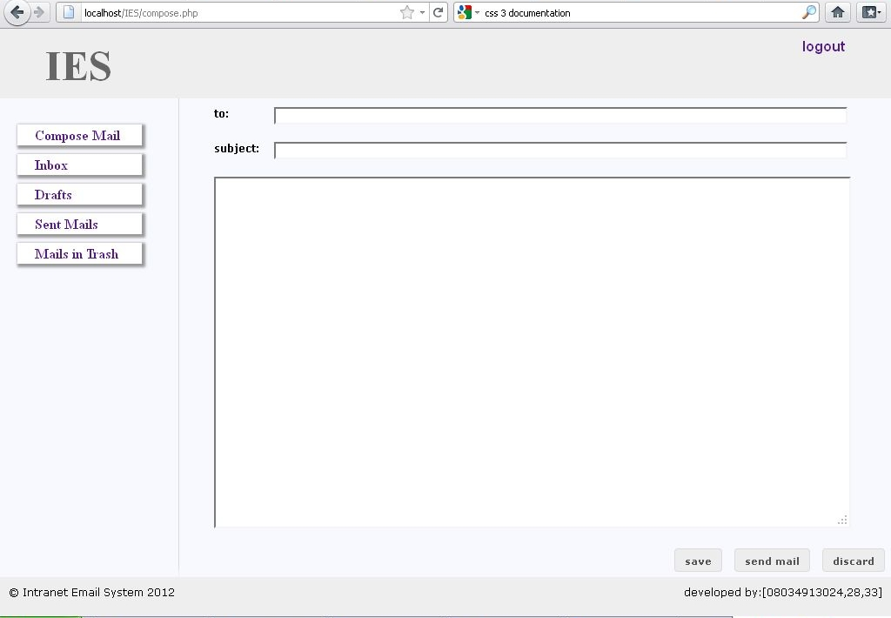
The compose page

Slide 18
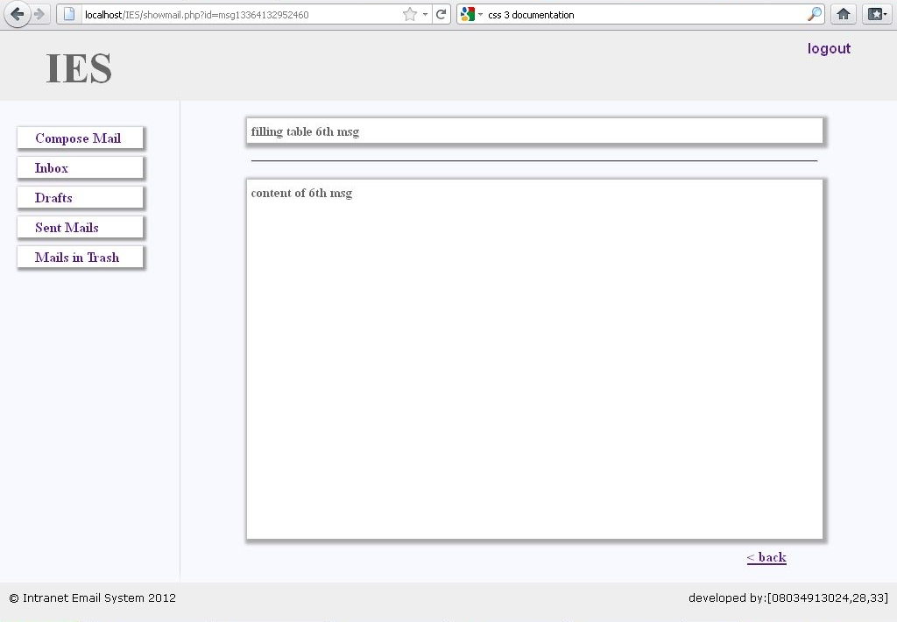
Viewing a Mail
From : user1234

Slide 19
Thank You
Prepared by:
Mridul Kashyap
Piyush Gupta
Priyam Gangwar
0834913024
0834913028
0834913033

